Slide 1
Graphs
It’s all about relationships
Mustafa Hajij
MSDS program University of San Francisco

Slide 2
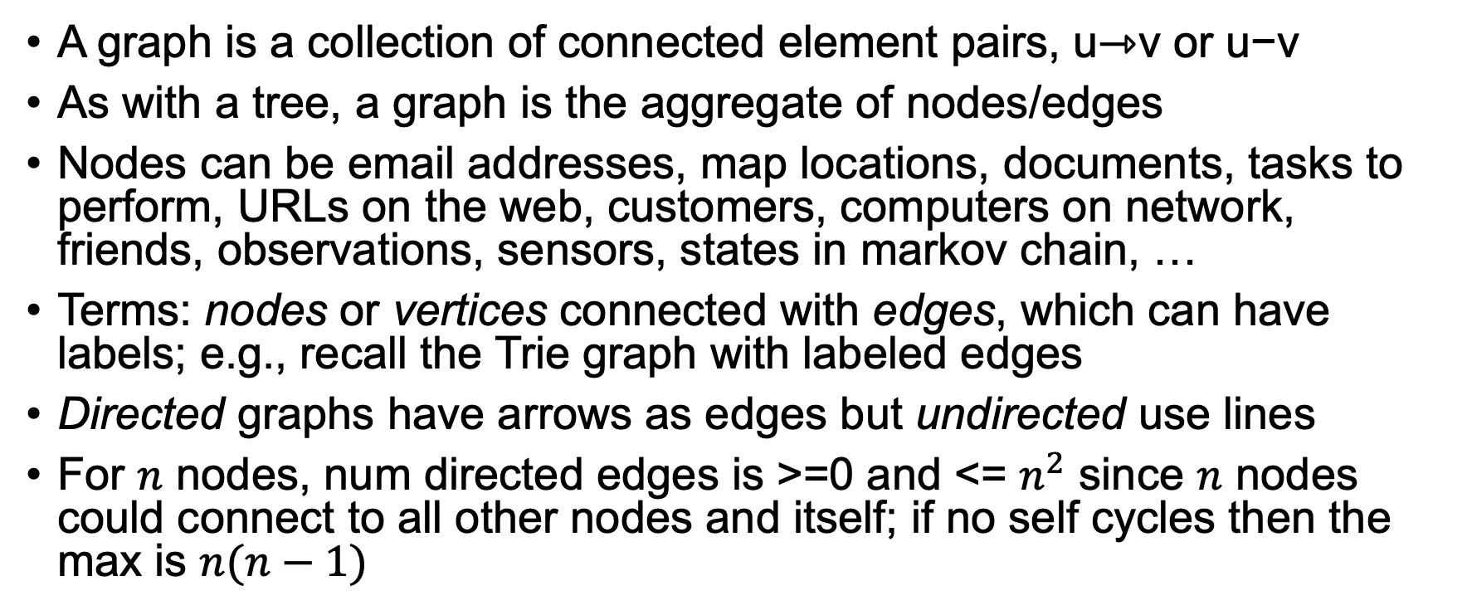
What’s a graph?
A graph is a collection of connected element pairs, u⇾v or u−v
As with a tree, a graph is the aggregate of nodes/edges
Nodes can be email addresses, map locations, documents, tasks to perform, URLs on the web, customers, computers on network, friends, observations, sensors, states in markov chain, …
Terms: nodes or vertices connected with edges, which can have labels; e.g., recall the Trie graph with labeled edges
Directed graphs have arrows as edges but undirected use lines
For $n$ nodes, num directed edges is >=0 and <= $n^{2}$ since $n$ nodes could connect to all other nodes and itself; if no self cycles then the max is $n(n−1)$

Slide 3
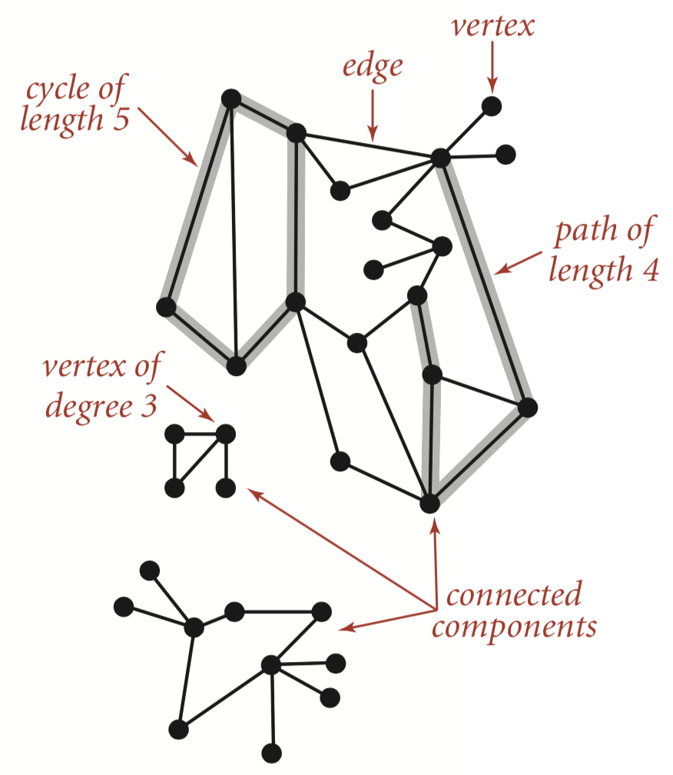
Undirected graph, terms
From: Algorithms book by Robert Sedgewick and Kevin Wayne

Slide 4
Facebook friend network, different layouts
Uses networkx
Fruchterman Reingold
spiral

Slide 5
Common questions
Is q reachable from p?
How many edges are on paths between p and q?
Is graph connected? (reach any p from any q)
Is graph cyclic? (p reaches p traversing at least one edge)
Which nodes are within k edges of node p? (neighborhood)
What is shortest path (num edges) from p to q?
What is shortest path using edge weights? [beyond scope of 689]
Traveling salesman problem [beyond scope of 689]
https://en.wikipedia.org/wiki/Travelling_salesman_problem

Slide 6
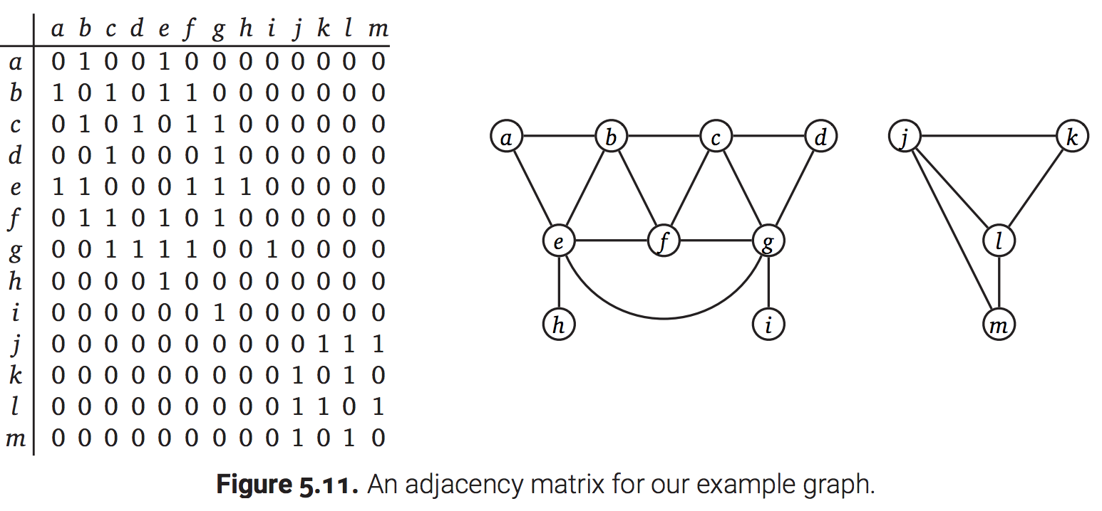
Adjacency matrix implementations
Adjacency matrix, n x n matrix of {0,1} if unlabeled or {labels} if edges are labeled; undirected matrices are symmetric
Wastes space for sparse edges; use sparse matrix
Fast to access arbitrary node’s edges if we have unique node IDs
http://jeffe.cs.illinois.edu/teaching/algorithms/book/05-graphs.pdf

Slide 7
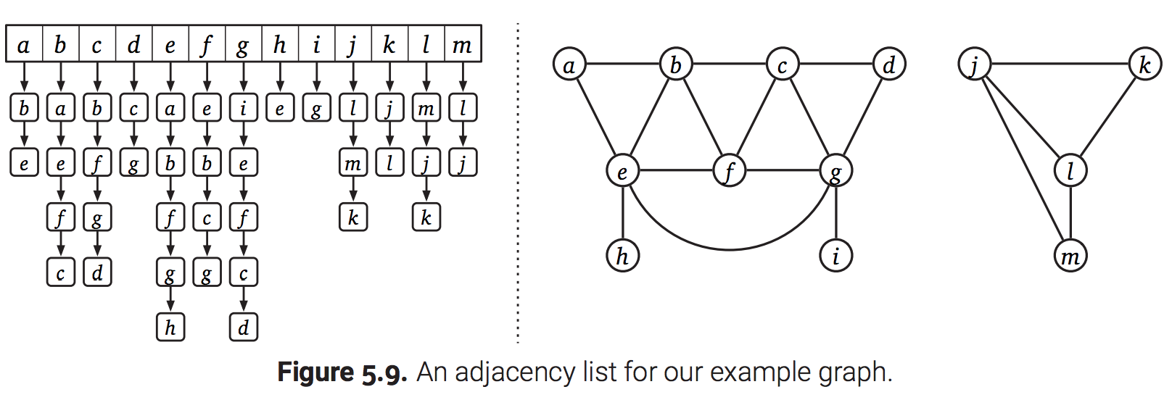
Adjacency list implementations
List of edge lists for nodes
Fast arbitrary node access for numbered nodes, space efficient
Acts like an index
http://jeffe.cs.illinois.edu/teaching/algorithms/book/05-graphs.pdf

Slide 8
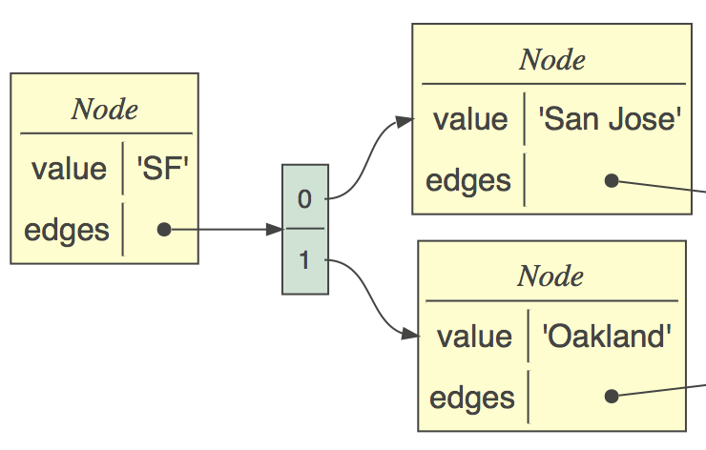
Connected nodes implementation
Common implementation due to nice mapping to objects
Each node has info about that node and its edge list
Use list or dictionary index if you need to access nodes directly
class Node:
def __init__(self, value):
self.value = value
self.edges = []
def edge(self, target:Node):
self.edges.append(target)

Slide 9
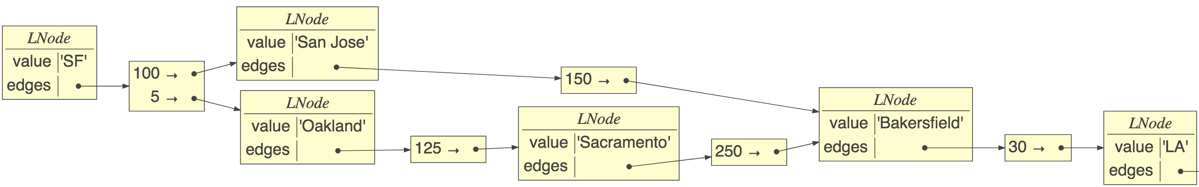
Implementation with labels
class LNode:
def __init__(self, value):
self.value = value
self.edges = {}
def edge(self, label, target):
self.edges[label] = target
Edge->node is a dictionary, not list
sf.edge(100,sj)
sj.edge(150,baker)
…

Slide 10
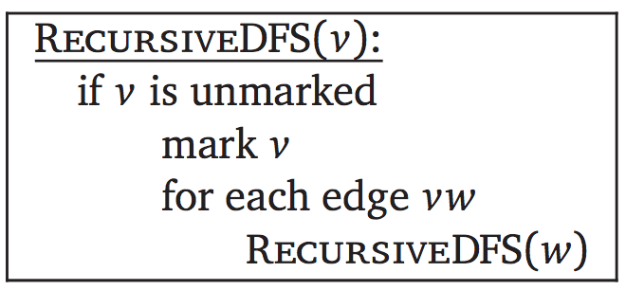
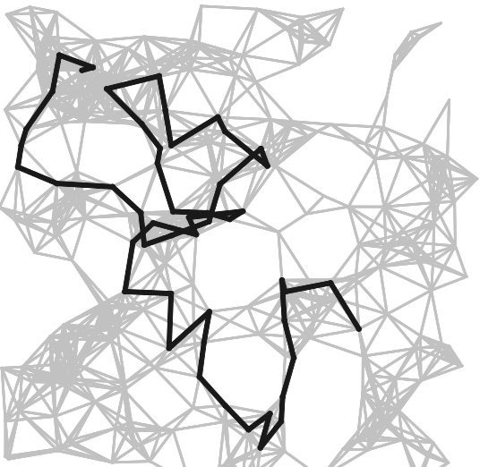
Depth-first search (review)
The fundamental algorithm for answering graph questions
Visits all reachable nodes from p, avoiding cycles
Go deep first
def walk_graph(p:Node, visited=set()):
if p in visited: return
visited.add(p)
for q in p.edges:
walk_graph(q, visited)
O(n,m) = n + m, for n nodes, m edges; m can be n^2 (counts node visits, edge traversals)
Algorithms book by Sedgewick, Wayne

Slide 11
Is there a cycle (p can reach p)?
E.g., can I get back to starting spot via one-way streets?
If we run into starting node in visited set, return True; blue means different than plain walk:
def iscyclic(p:Node) -> bool:
return iscyclic_(p,p,set())
def iscyclic_(start:Node, p:Node, visited) -> bool:
if p in visited:
if p is start: return True # we find start?
return False # can't loop forever so don’t chase
visited.add(p)
for q in p.edges:
c = iscyclic_(start, q, visited)
if c: return True # found it, we can stop
return False

Slide 12
Find set of nodes p can reach
https://github.com/parrt/msds689/blob/master/notes/graphs.ipynb
E.g., can we reach city y from city x (hint: Juneau not accessible)?
Need two sets, one for avoiding cycles, another for reached nodes
If we used visited for both, then p would also appear to reach itself, which might not be true; we add start node to visited but doesn't mean we can return to start via any path in graph
def reachable(p:Node) -> set:
reaches = set();
reachable_(p, reaches, set())
return reaches
def reachable_(p:Node, reaches:set, visited:set):
if p in visited: return
visited.add(p)
for q in p.edges:
reaches.add(q) # add only if we traverse
reachable_(q, reaches, visited)

Slide 13
Find set of nodes p can reach, track depth
E.g., how many hops from person A to B in social network?
Track node->depth map, not just set of nodes
def depths(p:Node) -> dict:
reaches = {}
depths_(p, reaches, depth=0)
return reaches
def depths_(p:Node, reaches:dict, depth:int):
if p in reaches: return
reaches[p] = depth # distance to p from start (could be 0)
for q in p.edges:
depths_(q, reaches, depth+1)
https://github.com/parrt/msds689/blob/master/notes/graphs.ipynb

Slide 14
Find neighborhood within k edges
E.g., find all friends within k friend hops
Track dict node->depth, stop when we reach depth
def neighbors(p:Node, k:int) -> dict:
reaches = dict()
neighbors_(p, k, reaches, depth=0)
return reaches
def neighbors_(p:Node, k:int, reaches:dict, depth:int):
if p in reaches or depth>k: return # terminate at depth
reaches[p] = depth
for q in p.edges:
neighbors_(q, k, reaches, depth+1)

Slide 15
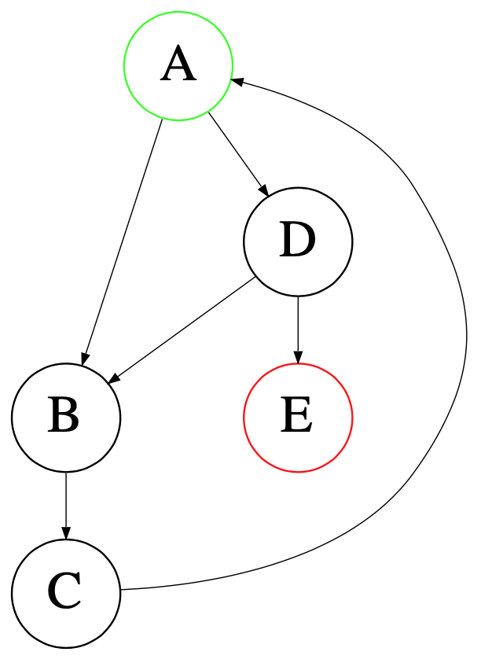
Find first path from p to q
Track path to each node
recursion tree
https://github.com/parrt/msds689/blob/master/notes/graphs.ipynb

Slide 16
Find first path from p to q
def path(p:Node, q:Node) -> list:
return path_(p, q, [p], set())
def path_(p:Node, q:Node, path:list, visited:set):
if p is q: return path # found q!
if p in visited: return None # avoid cycles
visited.add(p)
for e in p.edges:
pa = path_(e, q, path+[e], visited)
if pa is not None: return pa
return None
Must track path not just set of reachable nodes
https://github.com/parrt/msds689/blob/master/notes/graphs.ipynb

Slide 17
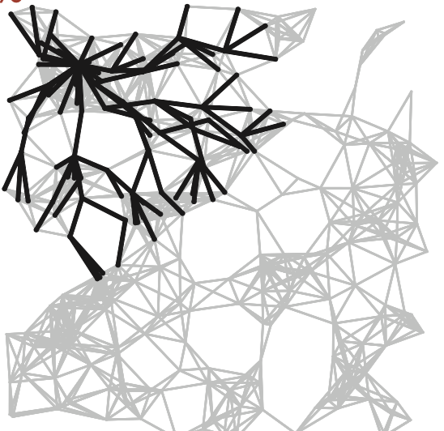
Breadth-first search vs DFS
Visit all children then grandchildren…
Algorithms book by Sedgewick, Wayne
Todo: show worklist growing/shrinking here or next slide (animation)

Slide 18
BFS implementation
Maintains work list of nodes and visited set
BFS DFS Visit A Visit A Visit B Visit B Visit D Visit C Visit C Visit D Visit E Visit E
Add to work list end, pull from front (queue)
Nonrecursive
def BFS(root:LNode):
visited = {root}
worklist = [root]
while len(worklist)>0:
p = worklist.pop(0) # dequeue
print(f“Visit {p}”)
for q in p.edges:
if q not in visited:
worklist.append(q)
visited.add(q)
https://github.com/parrt/msds689/blob/master/notes/graphs.ipynb

Slide 19
Find shortest path from p to q?
BFS where work list is a list of paths not list of nodes
Tail of path is where we left off working on it
By searching all children before going deeper, we auto- magically find paths with shortest (unweighted) lengths
def shortest(root:Node, target:Node):
visited = {root}
worklist = [[root]] # list of paths
while len(worklist)>0:
path = worklist.pop(0)
p = path[-1] # tail of path
if p is target: return path
for q in p.edges:
if q not in visited:
worklist.append(path+[q])
visited.add(q)
https://github.com/parrt/msds689/blob/master/notes/graphs.ipynb

Slide 20
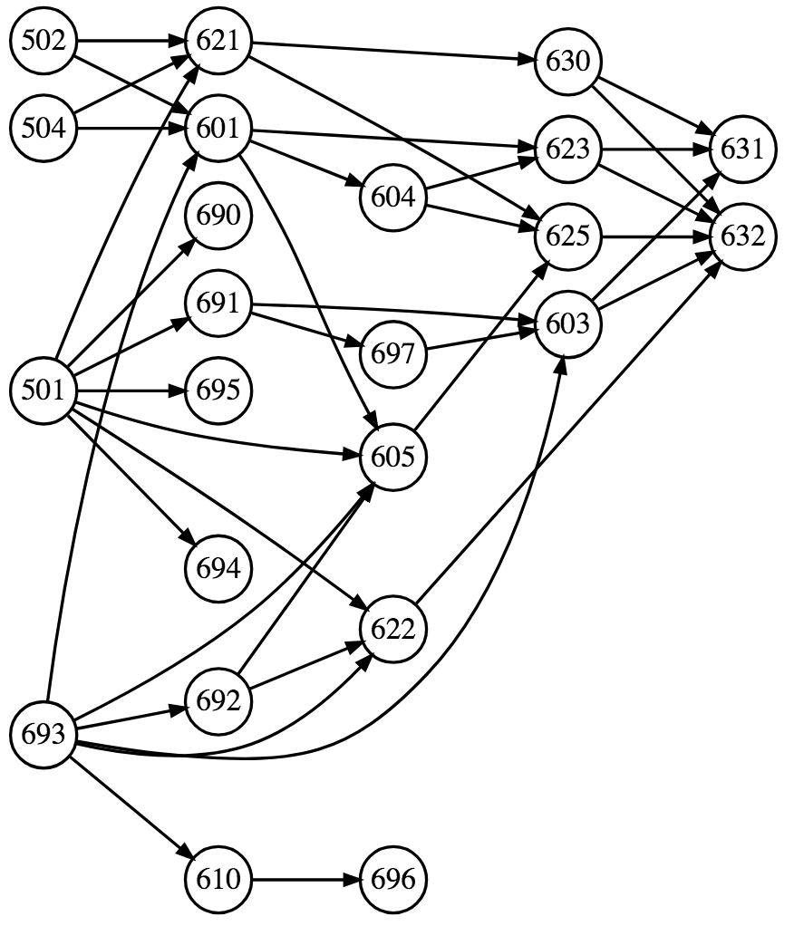
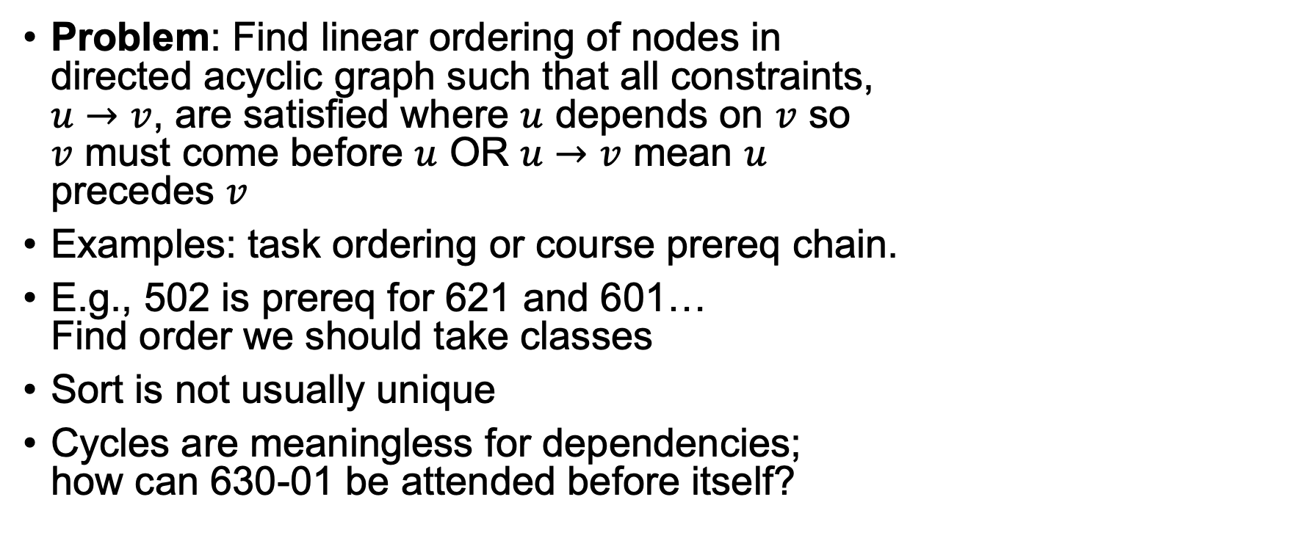
Topological sort (acyclic graphs)
Problem: Find linear ordering of nodes in directed acyclic graph such that all constraints, $u→v$, are satisfied where $u$ depends on $v$ so $v$ must come before $u$ OR $u→v$ mean $u$ precedes $v$
Examples: task ordering or course prereq chain.
E.g., 502 is prereq for 621 and 601… Find order we should take classes
Sort is not usually unique
Cycles are meaningless for dependencies; how can 630-01 be attended before itself?

Slide 21
Example topological sort (u depends v)
If u depends on v, any linear ordering where edges point to left is solution

Slide 22
Example where u precedes v
In this case, edges must point to the right

Slide 23
How to approach the problem
What order should we do these tasks (u depends v)? Think in terms of traversal order
What if we add party goal?
"Perform all children tasks then yourself"

Slide 24
DFS-based topo sort implementation
Lots of very complex algorithms on the web (not sure why)
Simplest solution: DFS-based topological sort
A valid sort is just the post-order graph traversal if u depends v!
Perform all children tasks then yourself
If u precedes v, reverse the result of post-order traversal; See proof page 582 of Sedgewick/Wayne Algorithms book
Well, we have to make sure to do DFS on all root nodes (nodes w/o incoming edges) but core is just DFS
With one root, it’s just postorder traversal via DFS

Slide 25
Example walk through
DFS starting with party: party -> 628 -> 630 back out then hit 689 then lunch back out and hit seminar
Postorder traversal processes/prints after visiting children: 630-01, lunch, seminar, 689-02, 628, party
Solution: 630-01, lunch, seminar, 689-02, 628 hw, party
https://github.com/parrt/msds689/blob/master/notes/graphs.ipynb

Slide 26
DFS postorder traversal
def postorder(p:Node, sorted:list, visited:set):
if p in visited: return
visited.add(p)
for q in p.edges:
postorder(q, sorted, visited)
sorted.append(p) # postorder done after kids
(recall: no cycles)

Slide 27
With multiple roots, hit them all
MSDS = """501->690
502,504,693->601
601->604
601,604->623
…"""
# nodes is dict edge list mapping from->to
def toposort(nodes:dict):
sorted = []
visited = set()
while len(visited) < len(nodes):
todo = [node for node in nodes.values()
if node not in visited]
if len(todo)>0:
anode = todo[0] # pick a node postorder(anode, sorted, visited)
return reverse(sorted)
We reverse postorder here since u precedes v

Slide 28
Summary
Graphs are for showing relationships between elements
DFS for finding a path or multiple paths or cycles (recursive backtracking to find all nodes)
BFS for find shortest (in edges) path or neighborhood
DFS postorder great for topo sort
Recursive alg’s all use visited set or similar to avoid cycles
Non-recursive DFS: (use work list stack)
push targets in reverse order onto work list
pop last work list item for next node to process
Non-recursive BFS: (use work list queue)
push targets in order onto work list
pull from first position

Slide 29
Sample graph problems

Slide 30
Exercise
Given a directed graph, detect all direct or indirect cycles
For p in nodes: report iscyclic(p)

Slide 31
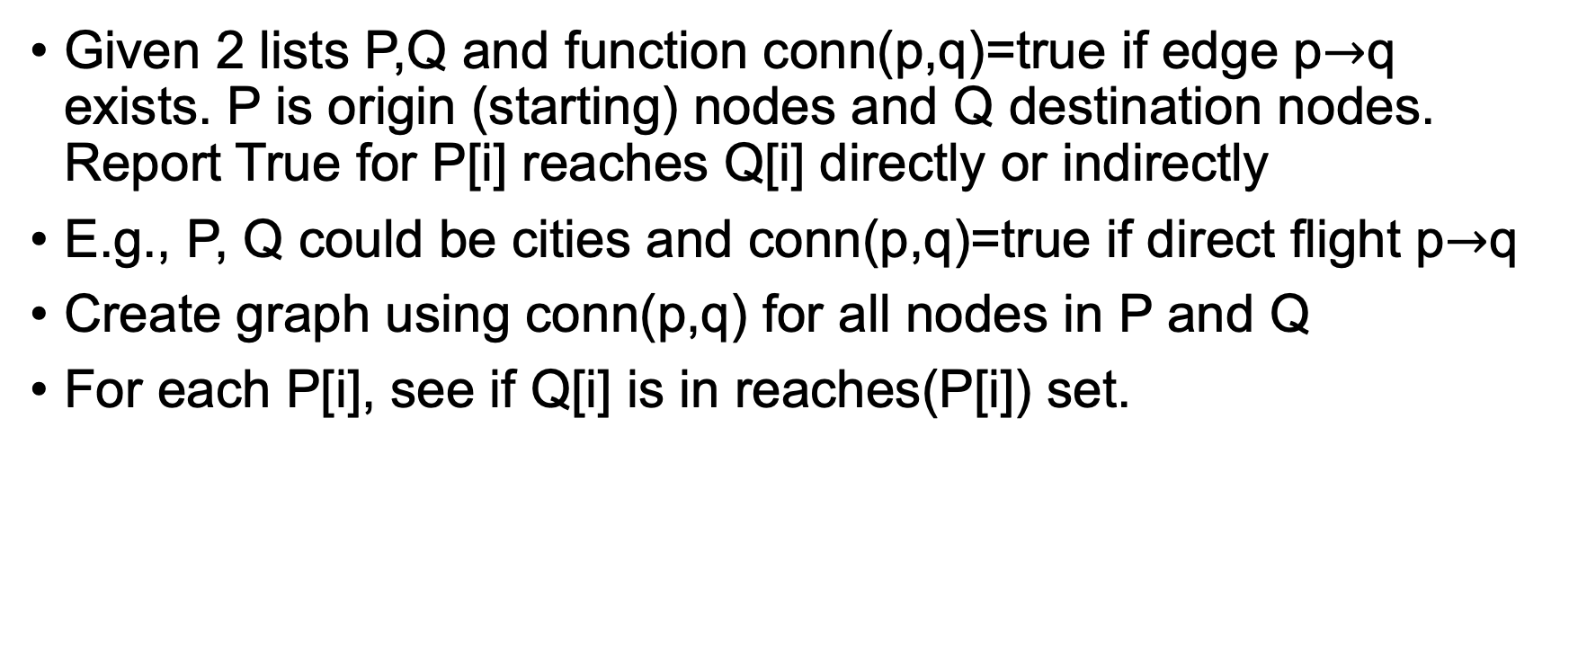
Exercise
Given 2 lists P,Q and function conn(p,q)=true if edge p$→$q exists. P is origin (starting) nodes and Q destination nodes. Report True for P[i] reaches Q[i] directly or indirectly
E.g., P, Q could be cities and conn(p,q)=true if direct flight p$→$q
Create graph using conn(p,q) for all nodes in P and Q
For each P[i], see if Q[i] is in reaches(P[i]) set.

Slide 32
Exercise: Boggle
Given m x n matrix of letters. Find all English words possible by taking one adjacent step to another letter, starting with any letter; one occurrence of each letter per word; you’re given a dictionary (/usr/share/dict/words)
For each node in graph, find all words
For a specific starting node p, perform cycle-avoiding DFS; at each node q, look up word consisting of all letters on path from p to q, checking for duplicated letters

Slide 33
Exercise: Find all words with given prefix
Find words beginning with "ap"
See https://github.com/parrt/msds689/blob/master/notes/code/prefix_trie.py

Slide 34
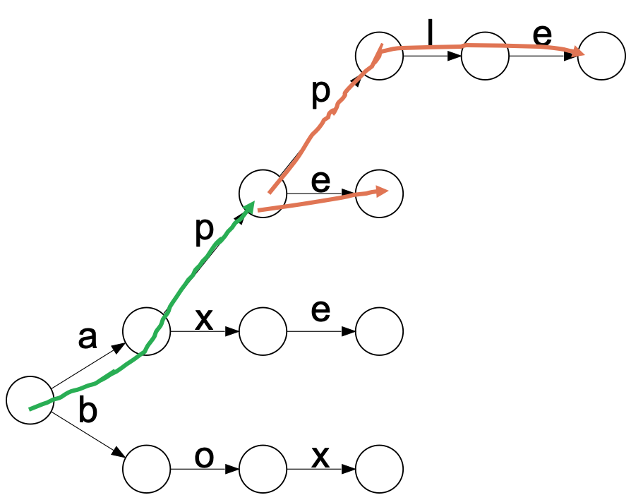
Exercise: Find all words with given prefix
Build a Trie with dictionary words
Find node in trie reached by prefix; call it p (green line)
Recursively, using depth first search, find all reachable leaf (stop/accept) nodes (orange lines)
Pass a path string as arg down the recursion chain to incrementally build strings reachable from p def suffixes_(p:TrieNode, path, paths): …
There can be no cycle so we don't worry about "visited" arg, just track the current path and the overall list of paths we found
See https://github.com/parrt/msds689/blob/master/notes/code/prefix_trie.py

Slide 35
Coding exercise: Visualize: FB friend graph with networkx
pip install networkx
download and uncompress https://snap.stanford.edu/data/facebook_combined.txt.gz
Get small sample of edges then do edge_subgraph(), draw_networkx_edges(), draw_networkx_nodes()
Need to pass positions of nodes for layout, such as circular_layout()
See https://github.com/parrt/msds689/blob/master/notes/code/viz_facebook.py

Slide 36
Coding exercise networkx: distances from SF to other cities
Download data: https://github.com/parrt/msds689/blob/master/notes/code/distances.csv
Create graph showing SF to other cities using multiple layouts
See https://github.com/parrt/msds689/blob/master/notes/code/sfo_city_distances.py

